Slide 1
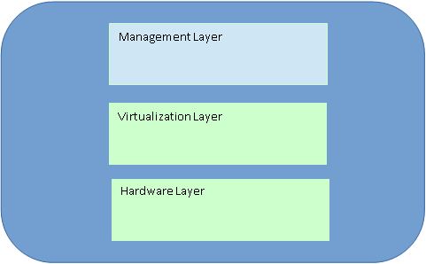
Building Blocks of Private Cloud
Private Cloud
Notes:
20

Slide 2
Virtualization Layer
Helps us o achieve several of the essential characteristics such as resource pooling.
Benefits
On-Demand Service Provisioning / Self-service is a primary feature of a private cloud environment. Users should be able to deploy new services on their own, or at least with minimal guidance from IT infrastructure administrators.
Multi-Tenancy – With multi-tenancy your private cloud can securely support different computing environment .
Simple Resource Scaling – As your environment grows you will have to add more resources such as RAM and storage.
Private Cloud
Notes:
20

Slide 3
The virtualization layer sits between the physical hardware and the cloud services.
It takes physical resources such as:
CPU
RAM
Storage
Network resources
and converts them into virtual resources that can be shared and managed efficiently.

Slide 4
For example, suppose a physical server has 64 GB RAM and 16 CPU cores. Virtualization can divide these resources among several virtual machines:
VM 1 → 16 GB RAM, 4 cores
VM 2 → 16 GB RAM, 4 cores
VM 3 → 16 GB RAM, 4 cores
VM 4 → 16 GB RAM, 4 cores
The users see virtual machines, rather than directly accessing the physical server.

Slide 5
“Helps us to achieve several of the essential characteristics such as resource pooling.”
Resource pooling means that physical resources are collected into a common pool and allocated to users/applications when required.
For example:
Imagine a private cloud has 10 physical servers.
Instead of dedicating one complete server to each department, virtualization allows the cloud administrator to create virtual machines using resources from the available servers.
So resources can be shared and allocated according to demand.

Slide 6
On-Demand Service Provisioning / Self-Service
This means users can create or obtain computing resources when they need them, without waiting for the administrator to manually configure a physical server.
For example:
A faculty member needs a server for a student project.
Instead of asking the IT administrator to purchase and configure a new physical machine, the private cloud can provide a virtual machine within minutes.
So:
Request → Virtual machine created → User starts working
This is called self-service provisioning.
The user may do it independently, or with minimal guidance from the IT administrator.

Slide 7
Multi-tenancy means that the same physical cloud infrastructure can support multiple users, departments, or applications while keeping their environments logically separated.
For example, in a college private cloud:
MCA Department → Virtual machines
CSE Department → Virtual machines
Administration → Virtual machines
Research Department → Virtual machines
All of them may use the same physical servers, but their virtual environments remain separated.
So, virtualization allows different tenants to securely share infrastructure.

Slide 8
This means that computing resources can be increased or decreased according to demand.
For example, suppose an application currently needs:
4 GB RAM + 2 CPU cores
Later, the number of users increases and the application needs:
8 GB RAM + 4 CPU cores
With virtualization, additional resources can be allocated to the virtual machine without necessarily replacing the entire physical server.
Similarly, resources can be reduced when demand decreases.

Slide 9
Hardware Layer (Physical Infrastructure)
The hardware layer represents the tangible, physical equipment housed inside an organization's private data center or a dedicated hosted facility.
Private Cloud
Notes:
20

Slide 10
Facility Infrastructure:
Networking:
Backup power generators, Uninterruptible Power Supplies (UPS), battery banks, and commercial cooling or HVAC systems to keep equipment running safely.
Physical network switches, routers, firewalls, and high-speed cabling that link servers and storage arrays together.
Private Cloud
Notes:
20

Slide 11
Networking:
Real-life example: When you upload a photo to Google Drive, the network equipment helps transfer your photo from your computer to Google's data centre, where it is stored.
In simple words: The networking infrastructure acts like a road system that allows data to travel between computers, storage devices, and the internet.
Private Cloud
Notes:
20

Slide 12
Networking:
Real-life example: When you upload a photo to Google Drive, the network equipment helps transfer your photo from your computer to Google's data centre, where it is stored.
In simple words: The networking infrastructure acts like a road system that allows data to travel between computers, storage devices, and the internet.
Private Cloud
Notes:
20

Slide 13
Management Layer (Control & Orchestration)
The management layer sits above the hardware and virtualization layers, translating human or API commands into automated infrastructure actions.
Cloud Management Platform (CMP):
Centralized software (such as OpenStack, VMware vCloud Director, or Microsoft SCVMM) that lets administrators provision and monitor resources.
Private Cloud
Notes:
20

Slide 14
Orchestration & Automation:
Identity & Access Management (IAM):
Tools that automatically deploy, scale, and tear down virtual machines, containers, and network policies without manual intervention
These are automatic manager that assigns resources, starts services, and performs routine tasks whenever needed, with minimal human intervention.
Policies, Role-Based Access Control (RBAC), and multi-factor authentication that govern who can access or change cloud resources
Private Cloud
Notes:
20

Slide 15
Challenges in Private Cloud
Huge investments
The cloud helps saving big amounts of money – this is one of the biggest benefits of cloud computing. However, you first need to get to this place.
Shared cloud solutions do not require additional hardware and software, this is not true for private clouds, there will be investment into IT infrastructure, into space to setup the infrastructure and large amounts of bandwidth to access that infrastructure from remote locations.
At the same time, the business and the IT users have to be trained for this initiative, which adds additional costs.
This is why, it’s recommended, if not necessary, that companies analyze the long term savings and infrastructure requirements before implementing a private cloud.
Private Cloud
Notes:
20

Slide 16
Challenges in Private Cloud
Huge investments
Private clouds, there will be investment into IT infrastructure, into space to setup the infrastructure and large amounts of bandwidth to access that infrastructure from remote locations.
Private Cloud
Notes:
20

Slide 17
Challenges in Private Cloud
IT Reluctance
So many changes and the unknowns of their role going forward usually make people from IT departments reluctant.
To facilitate this process, the management team should be involved with IT early, to explain the benefits of the migration and work on cross training the IT team to help with core competency initiatives that benefit the companies bottom line.
Private Cloud
Notes:
20

Slide 18
Challenges in Private Cloud
Defining the IT cost model
Once the cloud services have been implemented, how will the company allocate costs back to departments? Will it be time based or resource usage based.
IT will be part of defining a clear cost model.
Private Cloud
Notes:
20

Slide 19
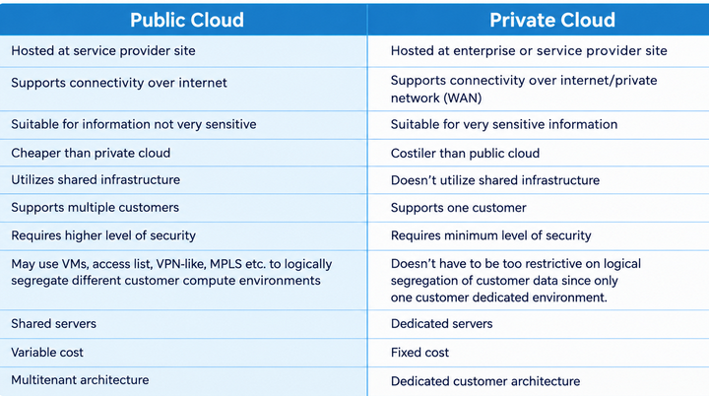
PUBLIC CLOUD VS PRIVATE CLOUD
Private Cloud
Notes:
20

Slide 20
UNIT-V
Notes:
20

